Slide 1
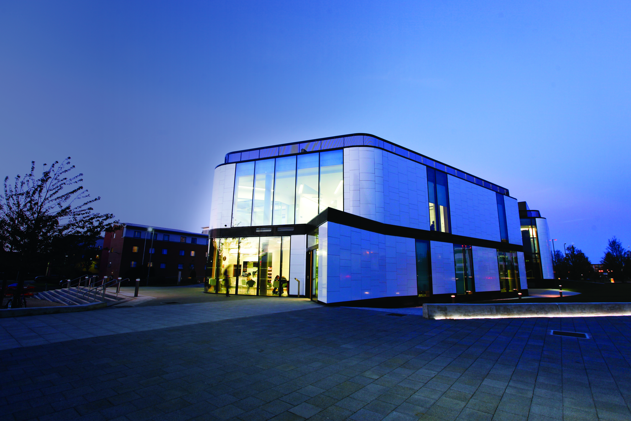
Hertfordshire Law Clinic
Amanda Thurston – Director of Law Clinic & Solicitor
Notes:
.

Slide 2
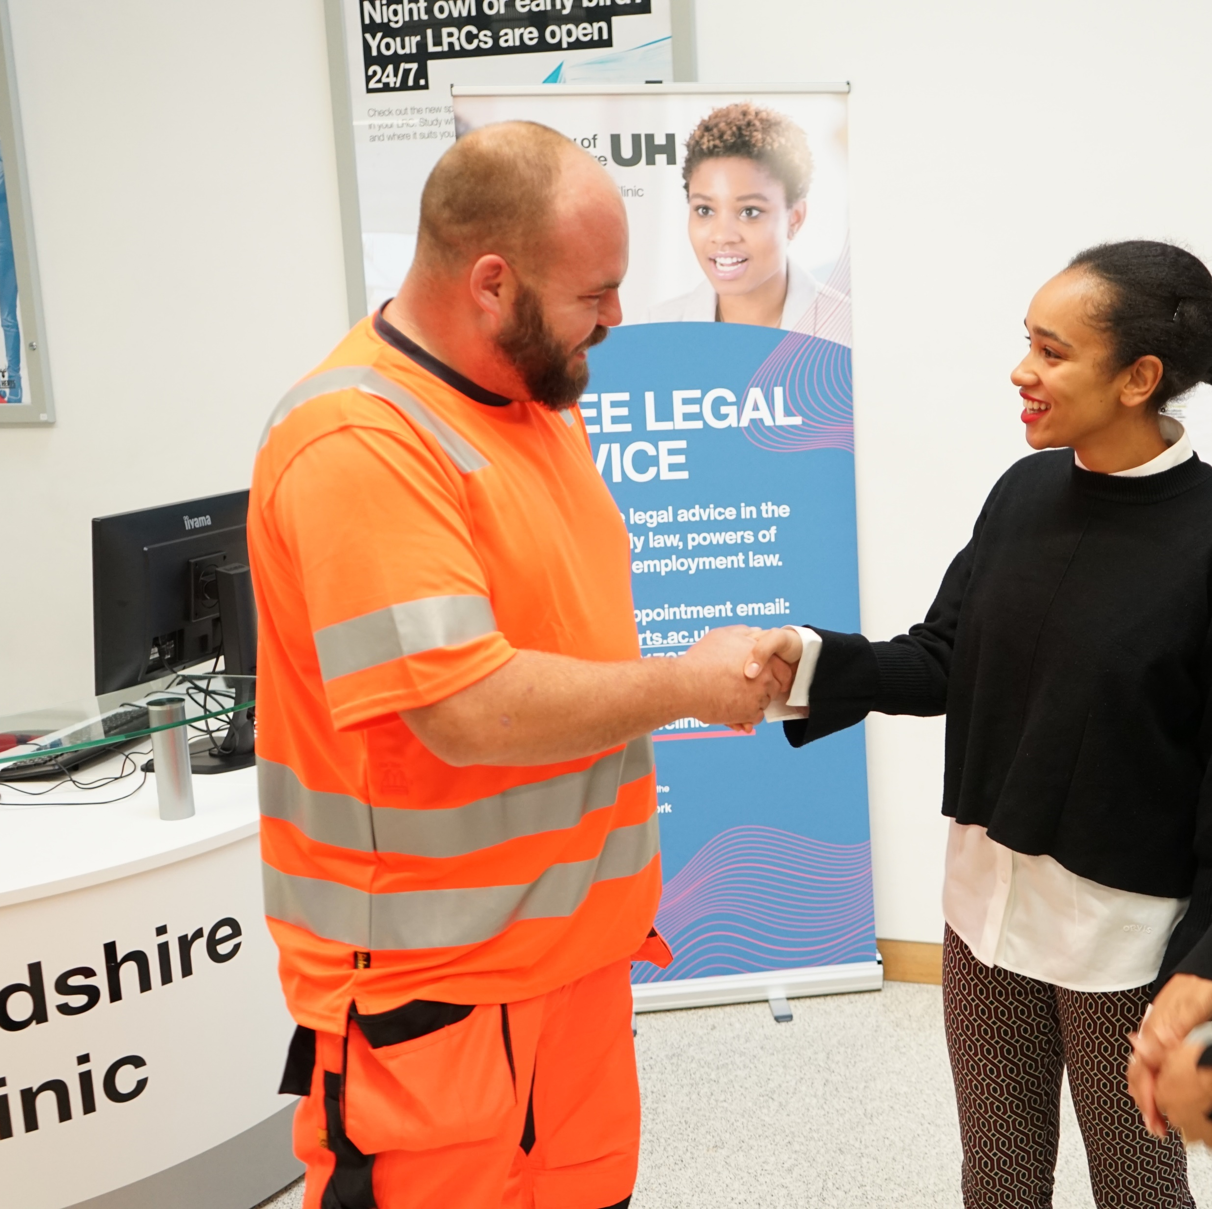

Opened in October 2019
Provides FREE advice in Family; Employment; Consumer/Contract; Housing; Property; Immigration; Commercial & IP; and Wills/Probate
Law Students trained to work in the clinic – shadowing lawyers; carrying out research; and drafting documents
Since March 2020 – all online

Slide 3
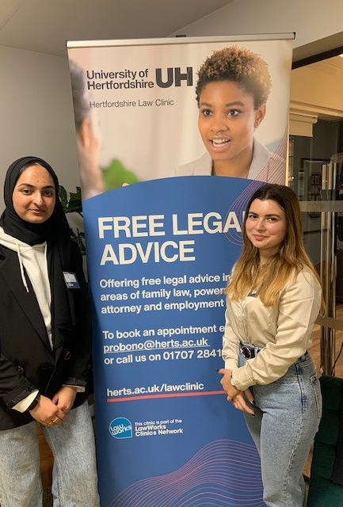
Contact Details
General Queries about the clinic or our Pro Bono work – email a.thurston@herts.ac.uk
Specific referrals to the clinic ie to get advice - call 01707 284115 or email probono@herts.ac.uk

