Slide 1
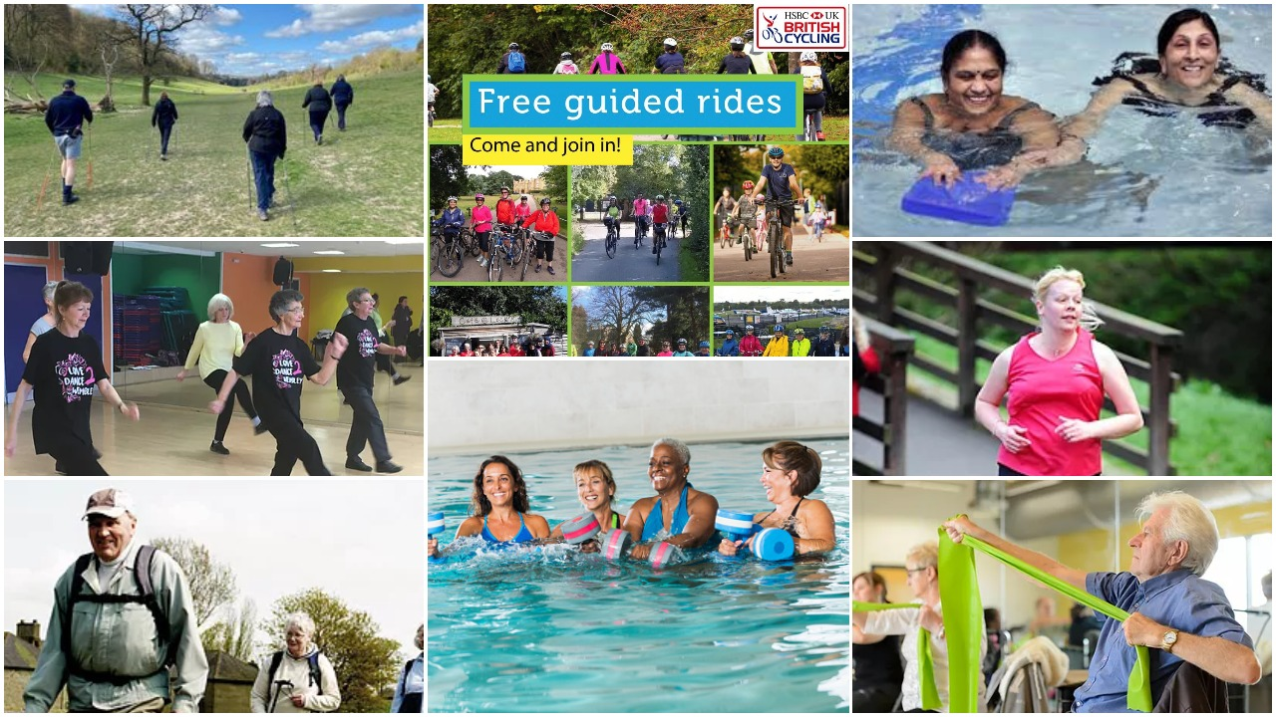
Watford Get Active - Supporting you to become active!
Activities include:
Ladies only swimming
Running
Nordic Walking
Health Walks
G.P referral
Love to Dance
Stroller fitness
Watford Cycle Hub
Free Tennis
Everyone Active

Slide 2
Three Rivers District Council’s Leisure Team runs a wide range of programmes to help you stay fit and healthy. All programmes were paused during lockdown and are slowly returning so check the website for up to date information.
www.threeriversleisure.co.uk/getactive

Slide 3
Everyone Active Gym
Now open for
Gym – 50 Minutes
Swim – Book Lane
Ladies Only - Friday Evenings
Activity | Adult | OAP | Concessions
Swimming | £5.00 | £2.40 | £3.20
Gym Session | £9.10 | £9.10 | £9.10
Classes | £7.00 | £7.00 | £7.00
Classes to return no earlier than Step3 (17th May
https://www.everyoneactive.com/

Slide 4
What to expect when Using exercise facilities
There may be changes now for you to use facilities
Book a gym time
Book a swim time
Have to wait for Exercise classes to return
Have one way systems
Go beach ready

Slide 5
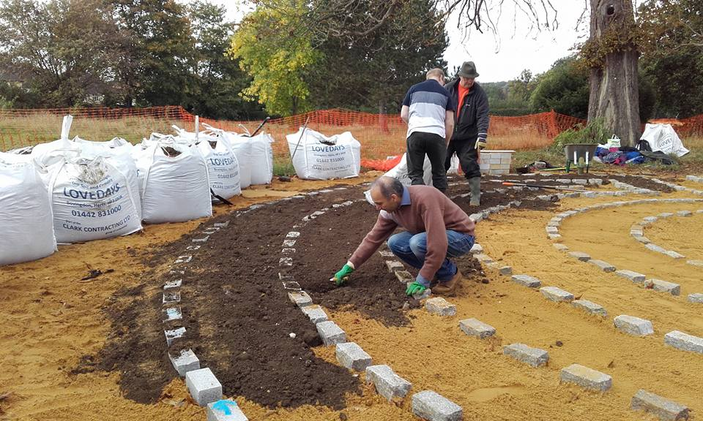
Watford Interfaith Peace Garden
Help you get active in the Park by helping to Maintain the Peace Garden
Wednesday 9.30 -11.30
Rabi Martins –
Rabimartins.cllr@gmail .com
mobile number
07494 450325

Slide 6
Gyms in Watford
The Gym Windsor Road
Pumped Gyms Tolpits Lane
NRG Watford High Street
Fitness For Less Watford High Street
Living Well Gym Elton Street

Slide 7
Watford Cycle Hub
WHAT WE DO:
Cycle training - Absolute Beginners and Confidence Booster courses, 1:1 training
Organised guided social rides - including ‘Breeze’, women only rides on Saturday at 12.30
Bike service and repairs
Reconditioned bikes and accessories for sale
Information on cycling and local routes
Café
WHERE WE ARE:
King George V Playing Fields, Tolpits Lane, Watford WD18 9QD
Open Tuesday to Saturday 9:00 – 5:00
FOR MORE INFORMATION:
Look on our website www.watfordcyclehub.org.uk
or call 01923 223994

Slide 8
Hertfordshire Healthwalks
Short Graded walks around the local areas
Free of charge
Looking start in May
For more information
https://www.hertfordshire.gov.uk/services/recycling-waste-and-environment/countryside-management/hertfordshire-health-walks/hertfordshire-health-walks.aspx

Slide 9
Ladies Only Gym Session

