Slide 1
COMMUNITY WELLBEING
LITTLE HADHAM VILLAGE HALL

Slide 2
1. Why focus on community wellbeing?
Due to Covid19, it became clear that the needs of our community had changed
What had changed and who was out there that could help us?
Notes:
We were and still are, a traditional village hall. However, as we know, Covid highlighted many social issues particularly for our elderly.
There has been a big impact on all our communities relating to isolation and loneliness and dealing with bereavement over and post lockdown. These things greatly affect peoples physical and mental wellbeing and if Covid has taught us anything, its is that medical intervention alone is not aways the answer.
We had heard about social prescribing and found Social prescribing link workers based at local GP practices.
They helped us connect us with a variety of other organisations to who offered practical and emotional support. Agencies like Red Kite who help with domestic abuse, Citizens Advice and others.
They also referred people to us, who they thought would benefit from the wellbeing activities we had started to introduce and one of the first wellbeing initiativies was our Bereavement Café

Slide 3
2. Restructuring & Refurbishment
Once we had realised that the Village Hall needed to offer more, we looked at changes we thought we could make
So what has changed?
Notes:
We knew we had to offer more for community wellbeing and we needed somethings to change to offer more activities related to health and wellbeing. Do enable this, looked at introducing more flexibility within our bookings calendar.
We didn’t have to make too many drastic changes to how we managed our hall bookings. But it did make us focus on how we managed hall availability for all our hall hirers more closely to make the best of the times and days available.
Other changes centred around refurbishment, creating a space where people wanted to be. A room previously leased as a Doctors surgery for many years, became available and we went about putting this space back into use.
Its our latest refurbishment project and is now used as a confidential space for meetings, counselling and health and wellbeing therapies.

Slide 4
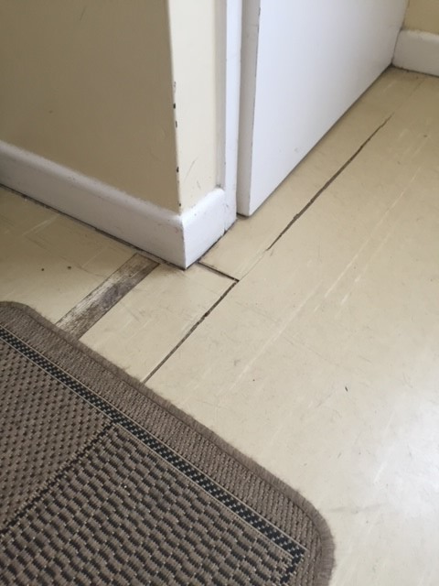
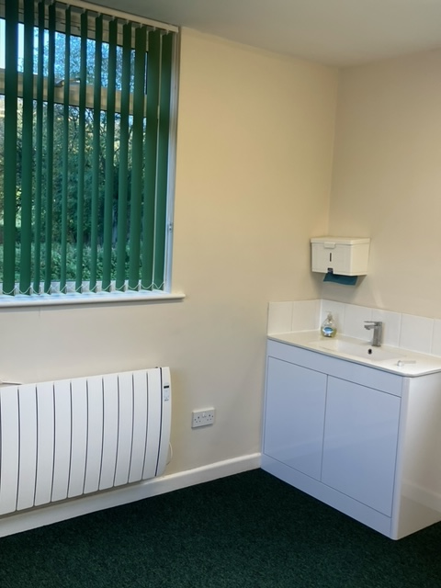
OUR MOST RECENT REFURBISHMENT PROJECT
Notes:
Before and after images of our meeting and counselling space
This room had been locked and out of use for more than two years due to Covid restrictions. It hadn’t been aired for a very long time and I’m afraid it didn’t smell too good but thankfully, its been cleaned up as you can see and is sweet smelling now!
Refurbishment was mostly carried out by volunteers and cost the Village Hall just shy of £2k, so not grant funded in this instance.

Slide 5
3. What community wellbeing activities are supported?
Afternoon Tea
Bereavement Café
Cinema - evening & relaxed afternoon film screenings
Community Breakfast
Digital Inclusion Workshops
Mum’s Matter
Coming soon - Warm Welcome Café
How are these funded?
Notes:
Some of our activities are weekly and some like afternoon tea, community breakfast, Bereavement cafe and cinema are monthly.
Without volunteers to run these, they simply wouldn’t happen. We are constantly networking to find out where funding might be available, telling the story of what we are doing and how we want to further support community wellbeing.
In 2020/21, half of our overall income came from grant funding, either for direct support for wellbeing initiatives or capital projects to improve our village hall environment.

Slide 6
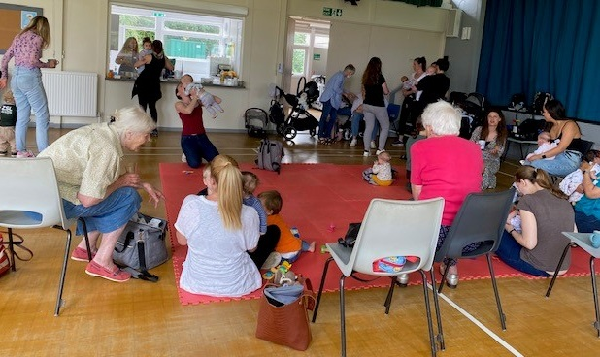
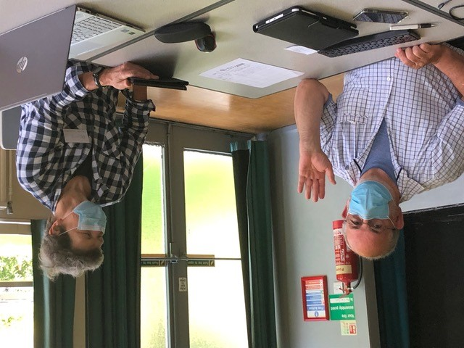
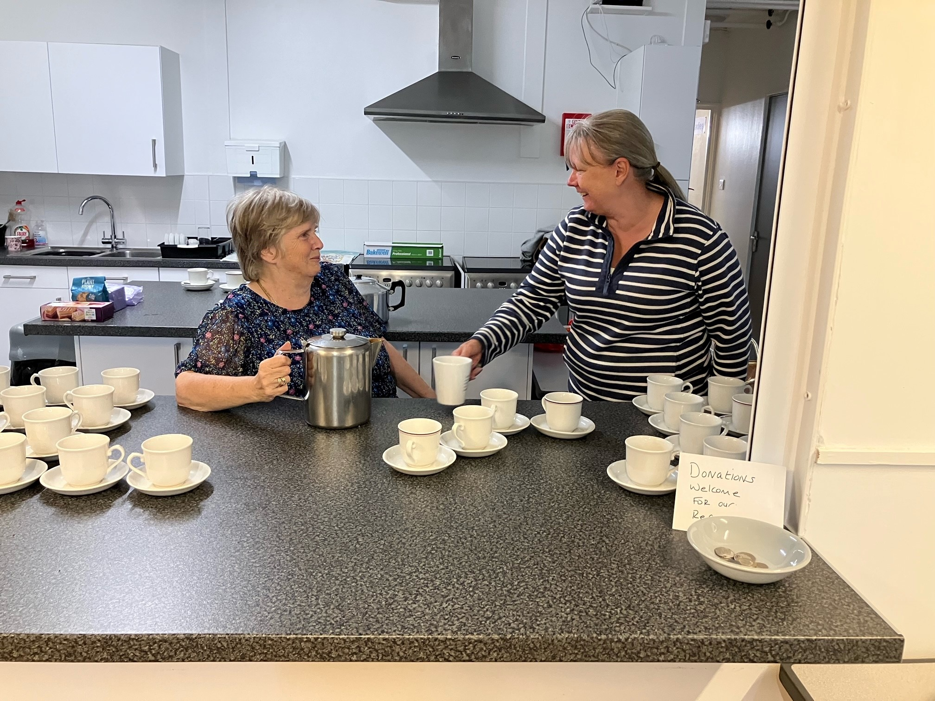
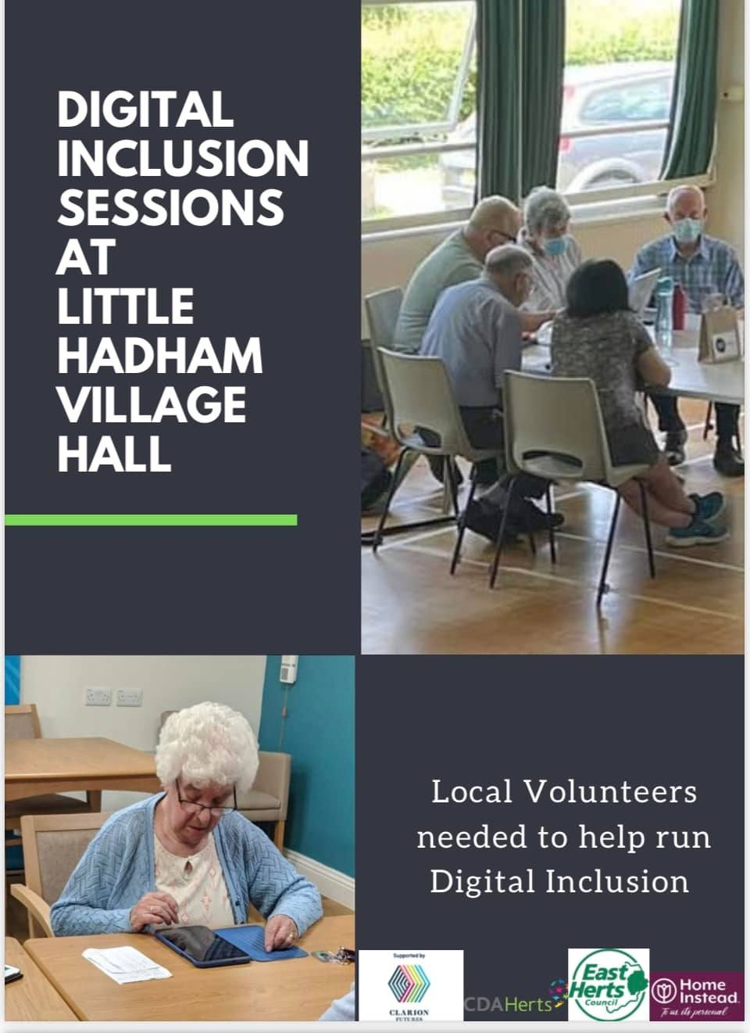
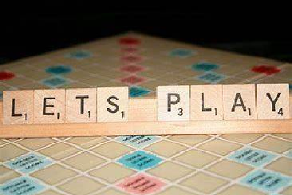
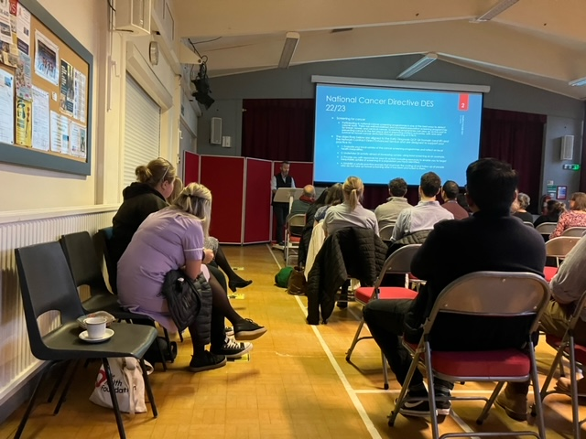
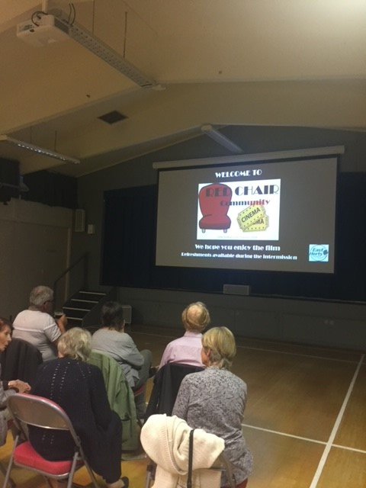
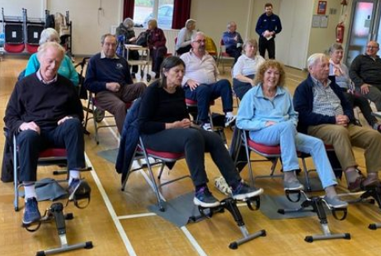
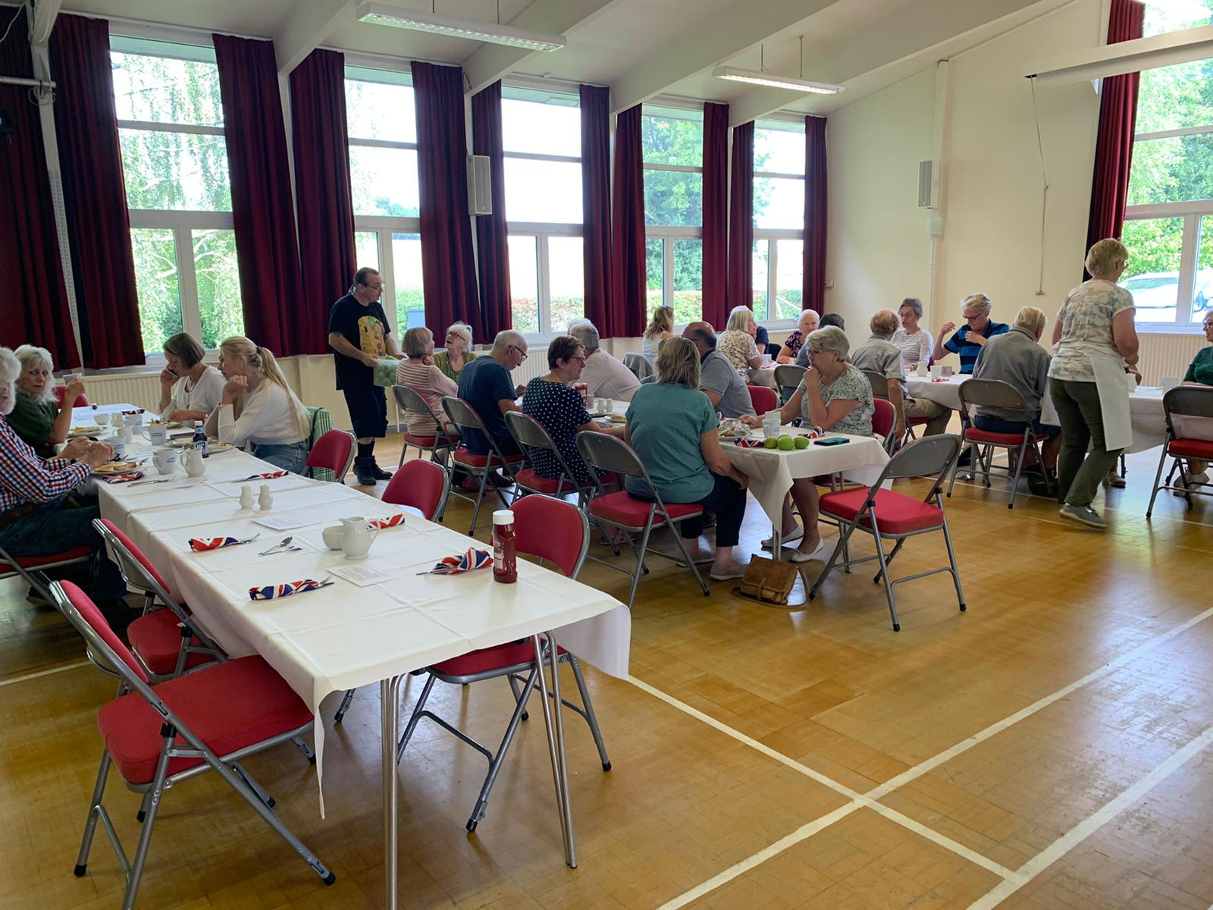
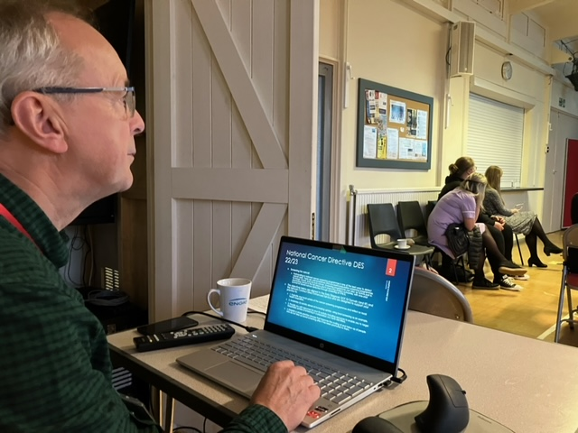
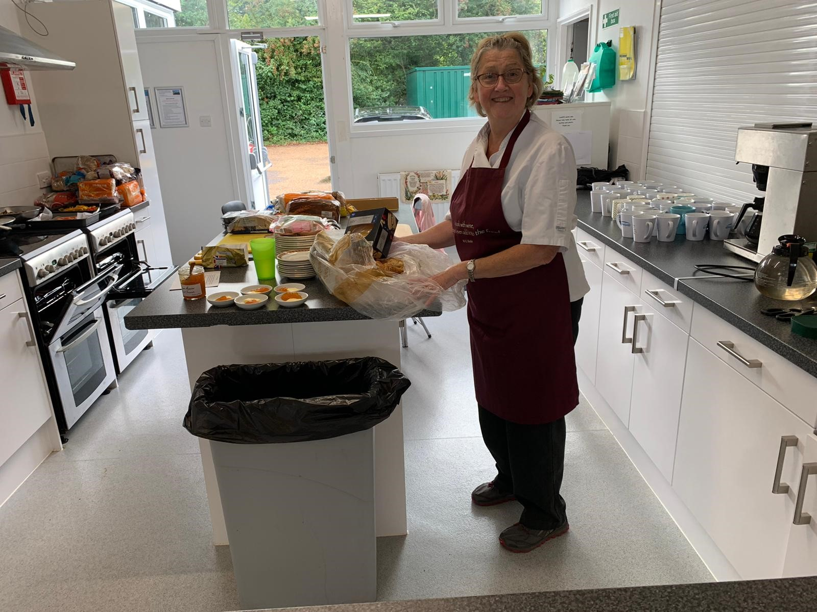
SOME OF OUR COMMUNITY WELLBEING ACTIVITIES
Notes:
Always need to remember to take photographs of activities or refurbishment, as it does help tell the story of what we doing for future grant funding opportunities.
We also need to let people know what community wellbeing activities we have on offer too, so try and keep our website up-to-date and where possible get permission to have email addresses for direct marketing of events.

Slide 7
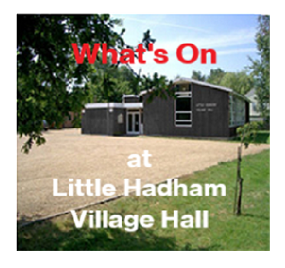
4. ‘LHVH What’s On’?
Visit our website for details: www.Littlehadhamvillagehall.com
How we advertise our activities;
Facebook
Nextdoor App
Little Hadham Parish Magazine
Village Hall noticeboards
Mailchimp –Email marketing
Word of mouth

Slide 8
5. What other community wellbeing initiatives are supported?
Live streaming
Conferences
Workshops
Training sessions
Covid & flu vaccinations
Who benefits from these facilities?
Notes:
The NHS has been a big influence in helping us promote our ability to live stream events from the hall, we can offer conferences, workshops and training facilities which have been grant funded by Ash Valley Community Hub and we can also support these events by providing refreshments from our new kitchen, grant funded in 2020 by Clarion Futures.
Doctors often find they have patients coming in asking the same questions throughout their working day. Offering workshops or seminars for patients allows for many other topics to be covered, e;g; diabetes, coping with autism
Key events we have held so far are;
Course of 4 menopause evening workshops run by nhs This brought medical professionals including specialists and consultants in front of people, on doctors appointments and in some cases possibly referrals.
We have hosted training for 60 nhs staff
Covid and flu vaccinations at weekends
CDA conference today
.

Slide 9
If you have a good community wellbeing activity at your venue that you would like to share, please let tell us about it.
Thank you for listening.
Notes:
.

