Slide 1
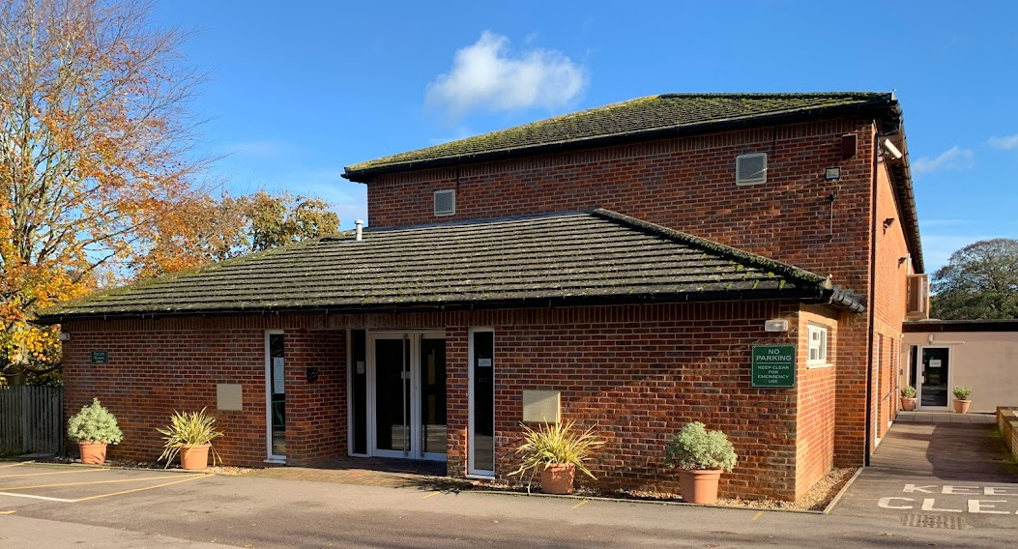
Kimpton Memorial Hall
Solar Panel Installation

Slide 2
HISTORY
Considered in 2013
Insufficient funds
Lack of enthusiasm

Slide 3
Why Now?
Email from village resident to Hall trustees
Greening Kimpton
Rising fuel costs
Money in the bank

Slide 4
Timeline March to November 2022
MARCH
APRIL/MAY
JULY
AUGUST
OCTOBER
NOVEMBER
Fact finding – advice from Tim H-S about possible grant source.
2 potential companies selected
Site visits and quotes
Investigation of possible grants
Roof inspection to assess suitability
Grant from Low Carbon Workspace approved
Roof inspection results to Building Control for Building Regulations approval
Proposal approved by trustees
Application for Permitted Lawful Development submitted to NHDC
Solinvictus commissioned to install system
Solar panels installed
Inverter installed
System commissioned and working

Slide 5
BENEFITS
Doing our bit for a greener Kimpton & the environment
Reduced electricity bills*
Income from selling unused electricity to National Grid
Investment paid back within 5 years
*Initial estimate = £2,500 saving per year (before fuel costs increased)

Slide 6
Installation Process
Solinvictus appointed August
Earliest mutually convenient start date October 3rd.
No new daytime booking taken for the agreed week
Installers worked round existing bookings
1 week to install everything except inverter**
Inverter installed 4 weeks later
System fully operational 7th November
**Delay due to worldwide shortage of inverters

Slide 7
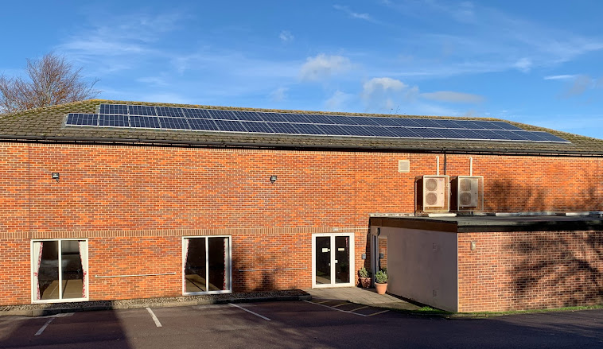
Installation Complete
38 panels

Slide 8
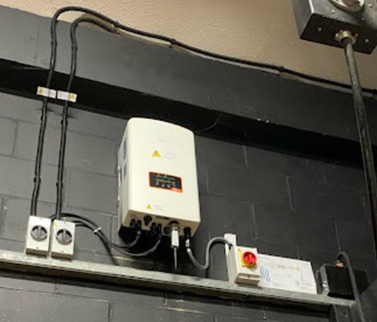
The Inverter

Slide 9
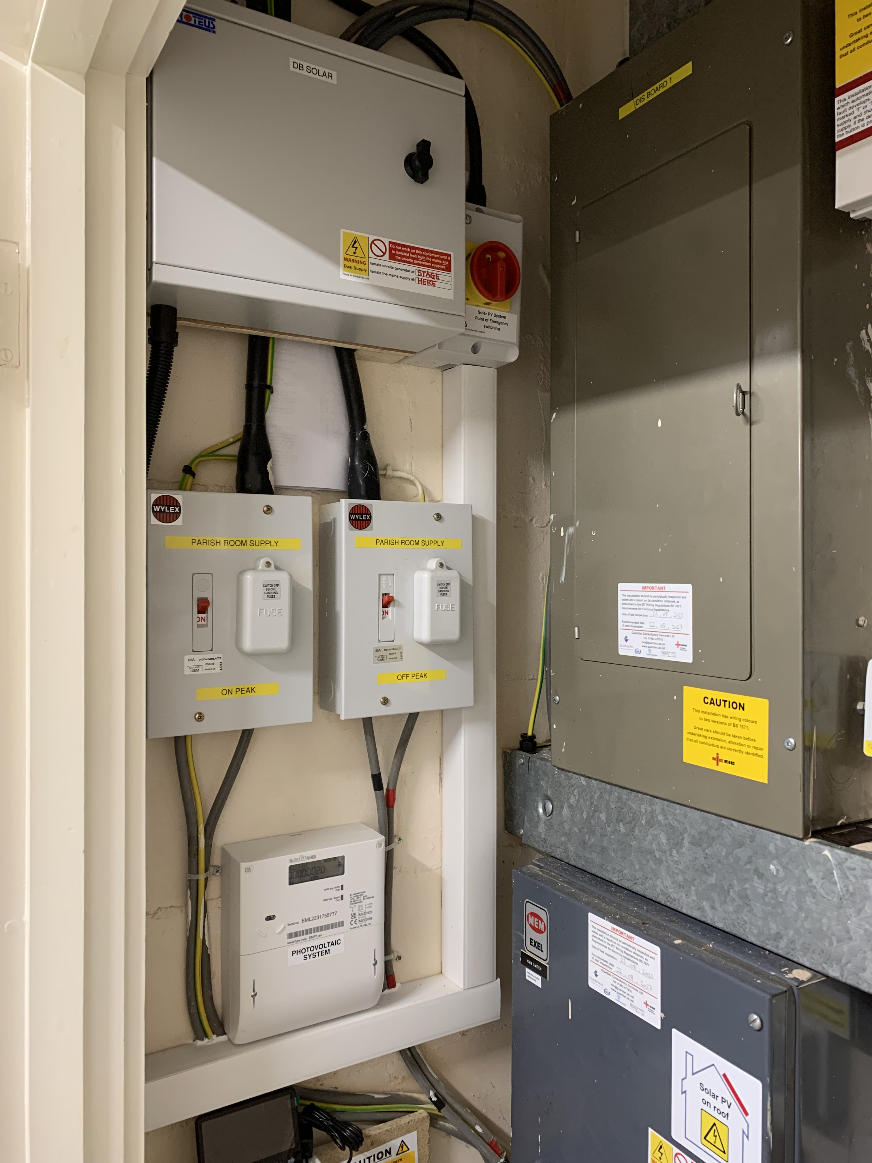
New additions to the ‘electricity cupboard’.

Slide 10
Costs
Building inspection £650
Lawful Development Application £263
Installation of system £16,686
Total £17,599
Low Carbon Workspace grant £ 5,000
Total cost to Hall £12,599

Slide 11
Barbara Kazwini
Booking Secretary
Kimpton Memorial Hall
Hall Lane,
Kimpton.
Herts.
SG4 8RD
www.kimptonmemorialhall.co.uk

