Slide 1
What we do
Why we’re here today
Can you help?
Notes:
First meeting with Claire Rice and Josie O’Driscoll
Invited to launch of a new hub by an activist and advocacy group in our patch, GATE Herts (Gypsy and Traveller Empowerment). HCC one of only two local authorities to include GRT communities in their suicide prevention planning. Sukhi.
Explained what we do, how we do it, and why we do it like that
There’s nothing like that for us - EXPLAIN
Almost no engagement by UK Samaritans with this community (apart from Festival branch, of which more later), something we’re about to put right

Slide 2
What we do
Our mission is that fewer people die by suicide
Our numbers: 200 branches, 20,000 volunteers, 24/7. Ware branch has 180 members – 10th founded, 7th biggest
A call every 10 seconds – from children facing stressful lives to people who feel they can’t go on
Outreach, advocacy, campaigns
Notes:
First meeting with Claire Rice and Josie O’Driscoll
Invited to launch of a new hub by an activist and advocacy group in our patch, GATE Herts (Gypsy and Traveller Empowerment). HCC one of only two local authorities to include GRT communities in their suicide prevention planning. Sukhi.
Explained what we do, how we do it, and why we do it like that
There’s nothing like that for us - EXPLAIN
Almost no engagement by UK Samaritans with this community (apart from Festival branch, of which more later), something we’re about to put right

Slide 3
Why we do it
In 2021, there were 5,291 suicides in England
74% male – 15.8 per 100,000, 26% female - 5.5 per 100,000
Suicide is the biggest killer of men aged 50 and under
Notes:
First meeting with Claire Rice and Josie O’Driscoll
Invited to launch of a new hub by an activist and advocacy group in our patch, GATE Herts (Gypsy and Traveller Empowerment). HCC one of only two local authorities to include GRT communities in their suicide prevention planning. Sukhi.
Explained what we do, how we do it, and why we do it like that
There’s nothing like that for us - EXPLAIN
Almost no engagement by UK Samaritans with this community (apart from Festival branch, of which more later), something we’re about to put right

Slide 4
How we do it
We give people someone to talk to
We listen and help them talk things through
We don’t judge and we keep things anonymous
We can help people explore their options and support them to make their own decisions
We can explore suicidal feelings with people
Notes:
First meeting with Claire Rice and Josie O’Driscoll
Invited to launch of a new hub by an activist and advocacy group in our patch, GATE Herts (Gypsy and Traveller Empowerment). HCC one of only two local authorities to include GRT communities in their suicide prevention planning. Sukhi.
Explained what we do, how we do it, and why we do it like that
There’s nothing like that for us - EXPLAIN
Almost no engagement by UK Samaritans with this community (apart from Festival branch, of which more later), something we’re about to put right

Slide 5
How we do it
Raising awareness among vulnerable groups
Men in lower socio-economic groups
Veterans, prisoners, gamblers, homeless, frontline workers
Men in rural communities
Notes:
First meeting with Claire Rice and Josie O’Driscoll
Invited to launch of a new hub by an activist and advocacy group in our patch, GATE Herts (Gypsy and Traveller Empowerment). HCC one of only two local authorities to include GRT communities in their suicide prevention planning. Sukhi.
Explained what we do, how we do it, and why we do it like that
There’s nothing like that for us - EXPLAIN
Almost no engagement by UK Samaritans with this community (apart from Festival branch, of which more later), something we’re about to put right

Slide 6
Why we’re here
Evidence suggests suicide rates are higher in rural areas and in rural-based occupations
Men in rural areas are less likely than men in urban areas to reach out for support or talk to someone if they are struggling with their mental health.
Why? Stigma; not knowing who to turn to; lack of awareness of what support is available
Notes:
First meeting with Claire Rice and Josie O’Driscoll
Invited to launch of a new hub by an activist and advocacy group in our patch, GATE Herts (Gypsy and Traveller Empowerment). HCC one of only two local authorities to include GRT communities in their suicide prevention planning. Sukhi.
Explained what we do, how we do it, and why we do it like that
There’s nothing like that for us - EXPLAIN
Almost no engagement by UK Samaritans with this community (apart from Festival branch, of which more later), something we’re about to put right

Slide 7
Why we’re here
Samaritans is running a campaign called Real People, Real Stories campaign with NFU Mutual to reach men in rural areas using case studies of people who have called us.
Jim McLaren MBE, farmer and chair of NFU Mutual, says: “I’m all too aware of how isolation is affecting rural communities. Feelings of uncertainty and overwhelming change have really challenged our mental health.”
Notes:
First meeting with Claire Rice and Josie O’Driscoll
Invited to launch of a new hub by an activist and advocacy group in our patch, GATE Herts (Gypsy and Traveller Empowerment). HCC one of only two local authorities to include GRT communities in their suicide prevention planning. Sukhi.
Explained what we do, how we do it, and why we do it like that
There’s nothing like that for us - EXPLAIN
Almost no engagement by UK Samaritans with this community (apart from Festival branch, of which more later), something we’re about to put right

Slide 8
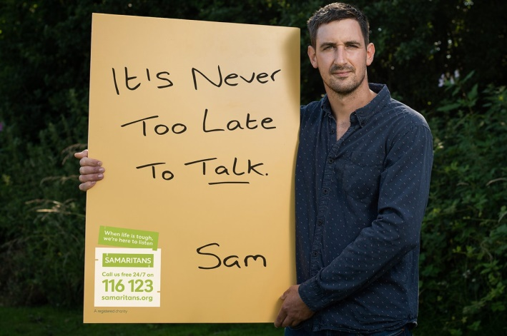
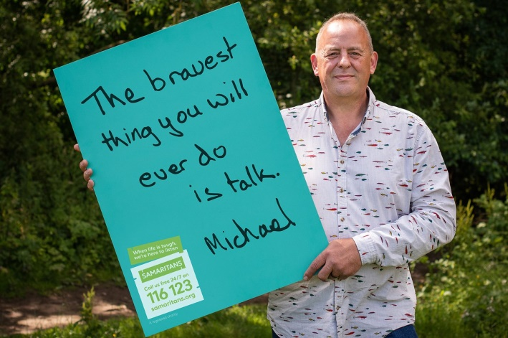
Real People, Real Stories
Sam's story
Michael's story
Notes:
First meeting with Claire Rice and Josie O’Driscoll
Invited to launch of a new hub by an activist and advocacy group in our patch, GATE Herts (Gypsy and Traveller Empowerment). HCC one of only two local authorities to include GRT communities in their suicide prevention planning. Sukhi.
Explained what we do, how we do it, and why we do it like that
There’s nothing like that for us - EXPLAIN
Almost no engagement by UK Samaritans with this community (apart from Festival branch, of which more later), something we’re about to put right

Slide 9
Why we’re here
Village halls are the hubs of these rural communities
We wanted to tell you about Real People, Real Stories
And we’ve brought some awareness raising materials and it would be great if you’d take them back to your villages
Notes:
First meeting with Claire Rice and Josie O’Driscoll
Invited to launch of a new hub by an activist and advocacy group in our patch, GATE Herts (Gypsy and Traveller Empowerment). HCC one of only two local authorities to include GRT communities in their suicide prevention planning. Sukhi.
Explained what we do, how we do it, and why we do it like that
There’s nothing like that for us - EXPLAIN
Almost no engagement by UK Samaritans with this community (apart from Festival branch, of which more later), something we’re about to put right

