Slide 1
Rising Energy Costs

Slide 2
How Does The Energy Crisis Impact you?
The energy crisis has been created by a ‘perfect storm’ of different environmental and political events.
These factors have contributed to the increase in the price of the wholesale energy markets which then get relayed to the consumer.
From the COVID-19 pandemic to climate change to the current war in Ukraine, prices for nearly everything we buy have gone up, especially energy.

Slide 3
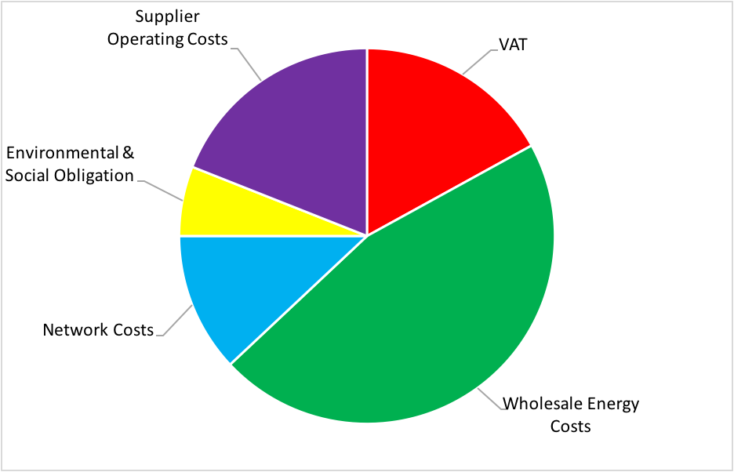
Energy bills are made up of several costs. They’re not just the gas and electricity you use. They include:

Slide 4
If I am up for renewal what are my options?
It all depends on your appetite for risk….
Organisations on out of contract rates or due for renewal imminently need to sign into a fixed protected contract for at least 12-months, this will provide you with budget security for the immediate term.
Organisations wanting to have budget security for a longer period we would offer alignment of their contracts under a protected and fixed contract for at least 24-months.
Remember there is a difference between fixed and fully fixed contracts. Always check the small print!

Slide 5
Fixed Vs Fully Fixed Contracts
All contracts are made up of commodity and non-commodity costs.
What is the difference between fixed and fully fixed?
Fixed term contracts, fix the commodity proportion which covers the cost for the energy itself.
Fully Fixed contracts fix both the commodity and non commodity costs for the contracted duration.

Slide 6
What can you do help reduce costs now?

Slide 7
Become greener – and save money too!
Create the culture - If you decide to cut energy consumption, make sure everyone is on board. Use organisation-wide meetings to brainstorm ideas and consider creating an energy champion. Keep communicating about the differences you are making – financially and environmentally.
Put an AMR on your wish list - An automated meter reading (AMR) device lets you review consumption in both operational and non-operational times. This ability to understand business patterns will hep you make better decisions on saving money.
Pick your energy firm wisely - Check you are getting value for money and if your tariff has dual rates, it may be prudent to carry out certain tasks during off-peak times.
Beware the ghost of energy past - Phantom energy is used by equipment plugged in but not in use. And it’s big. Try having all computer peripherals (printers, monitors etc) connected to power strips so one flip of a switch cuts all power.
Control the temperature - Heating, ventilation and air conditioning can account for 60% of energy costs. Think about setting temperature controls which only operate below 23C. A 1% thermostat adjustment can reduce energy costs up to 8%.

Slide 8
Become greener – and save money too!
Check equipment - Ensure your heating equipment has been serviced by qualified service agents. Make sure your radiators are balanced and air conditioners have been tested.
Check lights - Consider LED and low energy lighting.
Reduce paper waste - Printing less is a double saver. Less energy to run machines and less paper.
Promote - Tell your stakeholders what you are doing to be greener.

Slide 9
Remote Discovery Document
Working in collaboration with ACRE we have found that the biggest barrier rural community buildings face to reducing consumption on site is investment.
To combat this, we have we have created a remote site survey product that uses AI technology.
This reduces the upfront cost substantially.
If you wanted to learn more about this service, come and have a chat with us.

