Slide 1
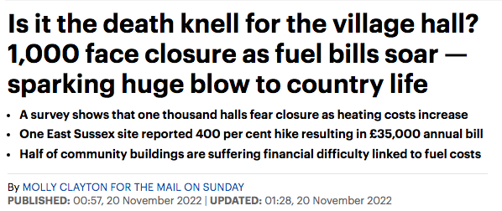
THE ENERGY PRICE SHOCK
MAIL ON SUNDAY 20 NOV 2022

Slide 2
THE ENERGY PRICE SHOCK
Examples of responses
* one month only
TOTAL ENERGY £/year
was | now | increase
6,500 | 11,500 | 180%
2,100 | 5,200 | 250%
4,600 | 16,400 | 360%
220* | 840* | 380%
1,970 | 8,600 | 440%
4,700 | 21,900 | 470%

Slide 3
THE ENERGY PRICE SHOCK
VARIABLES
energy supplier contract
energy efficiency of hall
utilization
financial performance
user behaviour

Slide 4
THE ENERGY PRICE SHOCK
ENERGY EFFICIENCY
thermal insulation, lighting, control system
annual energy cost £/sq.m
example 1 | £13.00
example 2 | £19.20
example 3 | £37.39
example 4 | £39.05

Slide 5
THE ENERGY PRICE SHOCK
UTILISATION AND FINANCIAL
(No increase in regular hire rates)
COLNEY HEATH VH | pre-covid | now
annual income | £18,700 | £21,200
OPEX | £13,200 | £15,000
surplus | £5,500 | £6,200
energy cost % income | 11% | 25%
energy cost % opex | 16% | 35%
utilisation | 70% | 78%

Slide 6
THE ENERGY PRICE SHOCK
WHAT TO DO ?
Get a better energy deal
improve user behavior
increase income
take sharp knife to all expenditure
invest – controls, door &window seals, LED, insulation

