Slide 1
Rural Digital Inclusion Programme
Weekly Digital Support & Guidance sessions delivered within Village Halls
Rural Digital Drop In Sessions
As the Covid Pandemic restrictions eased towards the end of summer 2021, there was a window of opportunity for us to commence our Rural Digital Inclusion Programme funded via grants from Clarion Futures & East Herts Council.
From late May last year, we have assisted in setting up regular ‘Drop In’ IT support sessions at 3 local Village Halls within rural East Herts.
At each of the venues, the Drop In sessions have become a regular activity, providing a welcoming and supportive learning opportunity for local people seeking free digital help and IT advice.
To date, we have assisted in the delivery of:-
107 weekly Free ‘Drop In’ Digital Inclusion sessions have been delivered across 3 village halls
1,390 hours of Digital support & advice has been provided
803 Digital Leaner attendances by 131 unique learners (ave 6 to 7 sessions per learner ie 12 to 14 hrs)
2085 hours of Digital Volunteers time has been given In Kind, equivalent to a monetary value of over £20k
4 Digital Champions formally trained and assisted by 25 local Digi-Buds
Our aim is to further develop, capacity build and sustain the Rural DI Programme over the next two years
whilst adding more DI sessions & IT learning opportunities at other Village Halls & community venues within rural Herts.

Slide 2
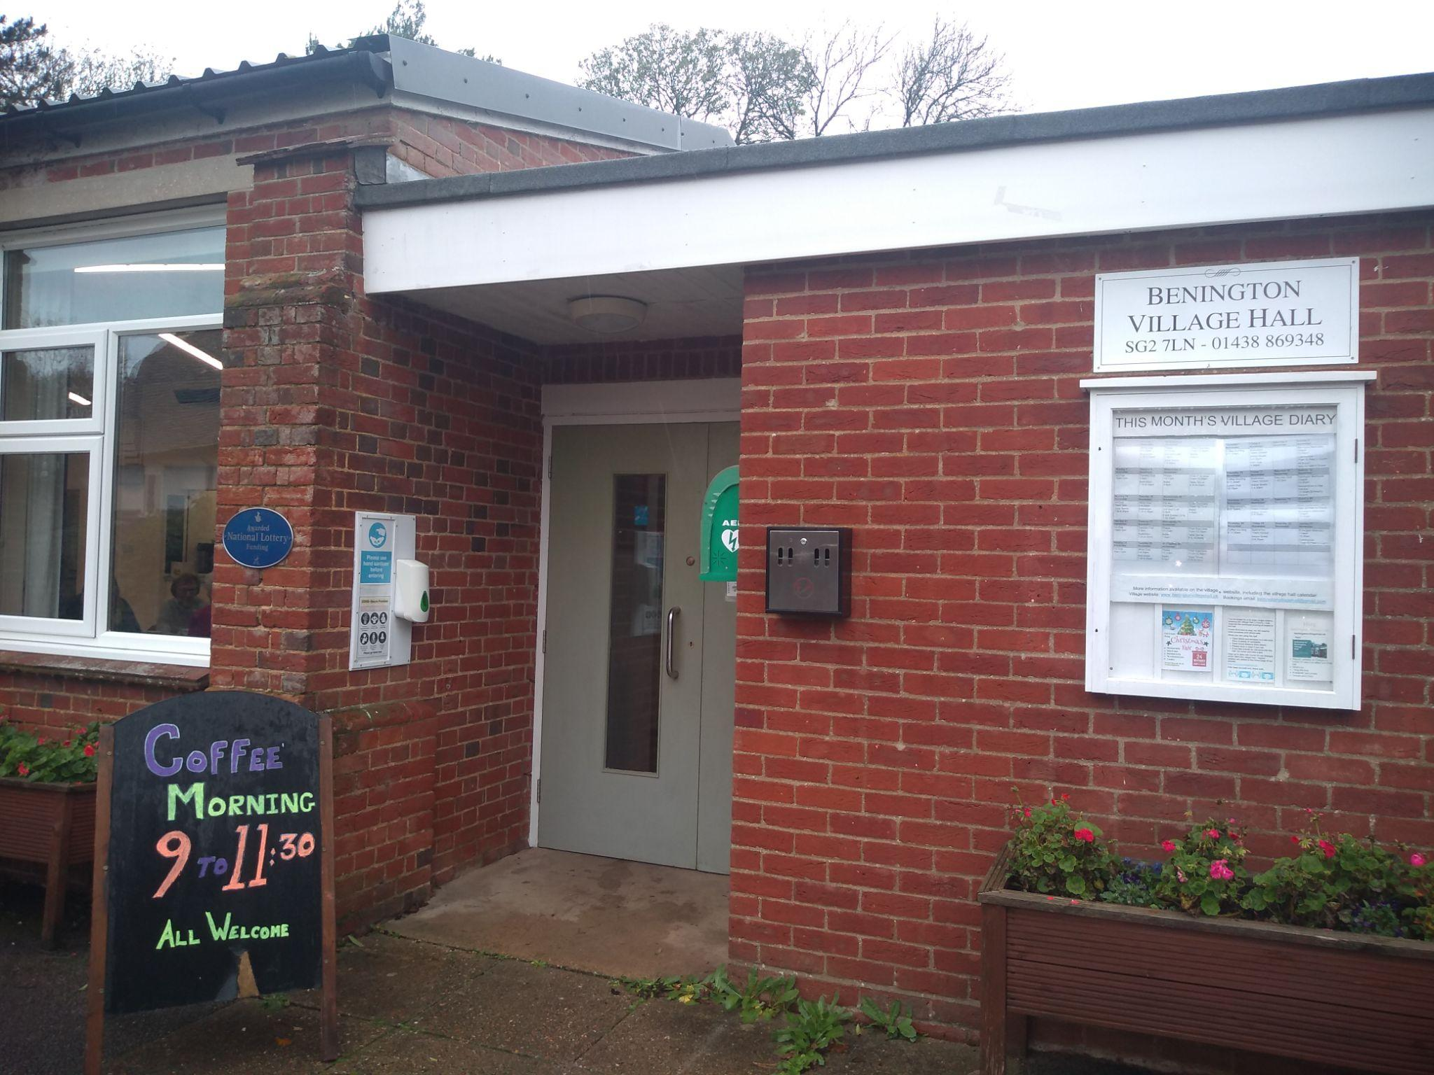
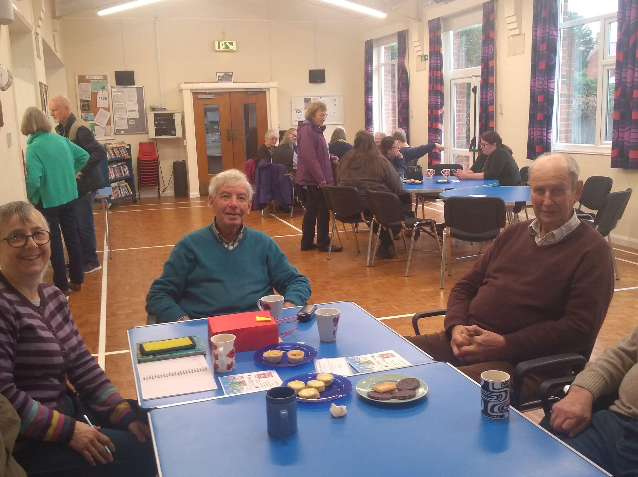
Rural Digital Inclusion Programme
Weekly Digital Support & Guidance sessions delivered within Village Halls
Case Study - Bennington Village Hall Thursday Coffee Morning - Digital Drop In Sessions
Notes:
Highlighting social prescribing and HertsHelp HCNS service in several of our newsletters, that gets sent out to over 400 organisations and Ethnically Diverse community groups and individuals
Setting up and continuing regular meetings with all the community engagement officers for each district, the community voluntary sector services (CVS) for each district and a Herts County Council representative, to come together to share their recent work, benchmark and work collaboratively and holistically to support their communities

Slide 3
Rural Digital Inclusion Programme
Weekly Digital Support & Guidance sessions delivered within Village Halls
Digital Drop In Sessions Format
Digital learners are assigned a Digital Champion (DC) or Digital Buddy (Digi-Bud) to help & assist them with their specific digital and IT queries.
No expectation to attend each week and people can simply drop in when they need some advice & assistance.
Having spare IT / digital devices available for learners to use is sometimes helpful, but not always essential.
Most learners tend to arrive with devices of their own and it’s far better to support learners using their own equipment which they have some familiarity with and use at home between sessions.
Some of the achieved Outcomes
Within every community there was an existing need for 'free to partake' DI schemes to be provided and maintained.
Location and the ability to access such support (ie transport to & from) and even a small financial cost can potentially form a barrier for those in most need wishing to get involved.
Sessions have helped & assisted learners in having to address the increasing demand to do more & more daily routines and procedures online / via the internet.
Other local service providers and support agencies have come forward to assist, recognising the value and benefits the project has in helping to improve people's lives through digital connectivity, not only with their families & friends, but also accessing their support services online.
Notes:
Highlighting social prescribing and HertsHelp HCNS service in several of our newsletters, that gets sent out to over 400 organisations and Ethnically Diverse community groups and individuals
Setting up and continuing regular meetings with all the community engagement officers for each district, the community voluntary sector services (CVS) for each district and a Herts County Council representative, to come together to share their recent work, benchmark and work collaboratively and holistically to support their communities

Slide 4
Rural Digital Inclusion Programme
Weekly Digital Support & Guidance sessions delivered within Village Halls
Key Lessons Learnt
The engagement, support and encouragement of local Digital Volunteers is key in making projects & schemes like this work and ultimately sustainable to continue for the long term.
There is another gap to fill in helping and assisting people to get online / improve their IT capabilities. This revolves around the provision of some form of free home based IT support as a local service.
With the right safeguarding measures & protocols in place, there’s a real opportunity for the development of small local social enterprises being established to support lonely & isolated people.
Two step verification & rural mobile signal coverage, continues to provides a real challenge within some isolated villages where network reception is poor / patchy.
Notes:
Highlighting social prescribing and HertsHelp HCNS service in several of our newsletters, that gets sent out to over 400 organisations and Ethnically Diverse community groups and individuals
Setting up and continuing regular meetings with all the community engagement officers for each district, the community voluntary sector services (CVS) for each district and a Herts County Council representative, to come together to share their recent work, benchmark and work collaboratively and holistically to support their communities

Slide 5
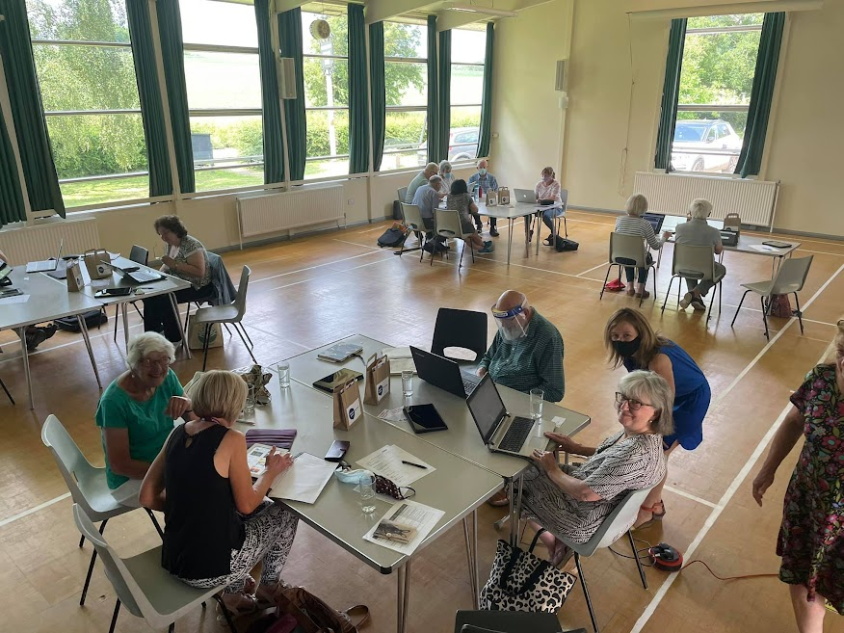
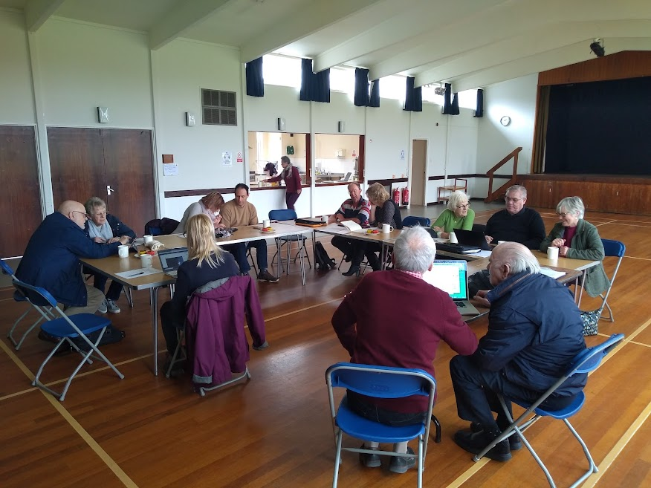
Rural Digital Inclusion Programme
Weekly Digital Support & Guidance sessions delivered within Village Halls
Datchworth Village Hall
Tuesday afternoon Digital Drop In Sessions
Little Hadham Village Hall
Wednesday afternoon Digital Drop In Sessions
Feedback from our Digital Learners
“The welcoming atmosphere of all volunteers and their patience and encouragement to a nervous OAP was wonderful”
“It is a very happy environment and I felt very relaxed when asking questions” “This cannot be improved. It was excellent”
“I liked the company of other people on the course. I have learned a lot about my phone and tablet. The coffee and cakes were amazing”
Notes:
Highlighting social prescribing and HertsHelp HCNS service in several of our newsletters, that gets sent out to over 400 organisations and Ethnically Diverse community groups and individuals
Setting up and continuing regular meetings with all the community engagement officers for each district, the community voluntary sector services (CVS) for each district and a Herts County Council representative, to come together to share their recent work, benchmark and work collaboratively and holistically to support their communities

